Slide 1
UNIT-VI
Digital Electronics

Slide 2
UNIT-VI-Digital Electronics: Syllabus
Number Systems - Binary Codes - Binary Arithmetic- Boolean Algebra, Laws & Theorems - Simplification of Boolean Expression using K maps- Logic Gates – Implementation of Boolean Expression is using logic gates – Standard forms of Boolean Expression.

Slide 3
Number Systems
In digital electronics, the number system is used for representing the information.
The number system has different bases and the most common of them are the decimal, binary, octal, and hexadecimal.
The base or radix of the number system is the total number of the digit used in the number system.
Suppose if the number system representing the digit from 0 – 9 then the base of the system is the 10.

Slide 4
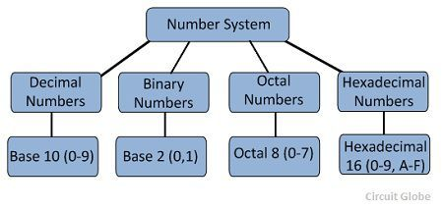
Types of Number Systems
Some of the important types of number system are
i)Decimal Number System
ii)Binary Number System
iii)Octal Number System
iv)Hexadecimal Number System

Slide 5
1. Decimal Number Systems
The number system is having digit 0, 1, 2, 3, 4, 5, 6, 7, 8, 9; this number system is known as a decimal number system because total ten digits are involved. The base of the decimal number system is 10.
2. Binary Number Systems
The modern computers do not process decimal number; they work with another number system known as a binary number system which uses only two digits 0 and1.The base of binary number system is 2 because it has only two digit 0 and 1.The digital electronic equipments are works on the binary number system and hence the decimal number system is converted into binary system.
The table is shown below the decimal, binary, octal, and hexadecimal numbers from 0 to 15 and their equivalent binary number. Showing 1 to 16 of 16 entries

Slide 6
3. Octal Numbers
The base of a number system is equal to the number of digits used, i.e., for decimal number system the base is ten while for the binary system the base is two.
The octal system has the base of eight as it uses eight digits 0, 1, 2, 3, 4, 5, 6, 7.
All these digits from 0 to 7 have the same physical meaning as by decimal symbols, the next digit in the octal number is represented by 10, 11, 12, which are equivalent to decimal digits 8, 9, 10 respectively.
In this way, the octal number 20 will represent the decimal digit and subsequently, 21, 22, 23.. Octal numbers will represent the decimal number digit 17, 18, 19… etc. and so on.

Slide 7
4. Hexadecimal Numbers
These numbers are used extensively in microprocessor work. The hexadecimal number system has a base of 16, and hence it consists of the following sixteen number of digits.
0, 1, 2, 3, 4, 5, 6, 7, 8, 9, A, B, C, D, E, F.
The size of the hexadecimal is much shorter than the binary number which makes them easy to write and remember.
Let 0000 to 000F representing hexadecimal numbers from zero to fifteen, then 0010, 0011, 0012, …etc. Will represent sixteen, seventeen, eighteen… etc. till 001F which represent thirty open and so on.

Slide 8
Decimal | Binary | Octal | Hexadecimal
0 | 0000 | 0 | 0
1 | 0001 | 1 | 1
2 | 0010 | 2 | 2
3 | 0011 | 3 | 3
4 | 0100 | 4 | 4
5 | 0101 | 5 | 5
6 | 0110 | 6 | 6
7 | 0111 | 7 | 7
8 | 1000 | 10 | 8
9 | 1001 | 11 | 9
10 | 1010 | 12 | A
11 | 1011 | 13 | B
12 | 1100 | 14 | C
13 | 1101 | 15 | D
14 | 1110 | 16 | E
15 | 1111 | 17 | F

Slide 9
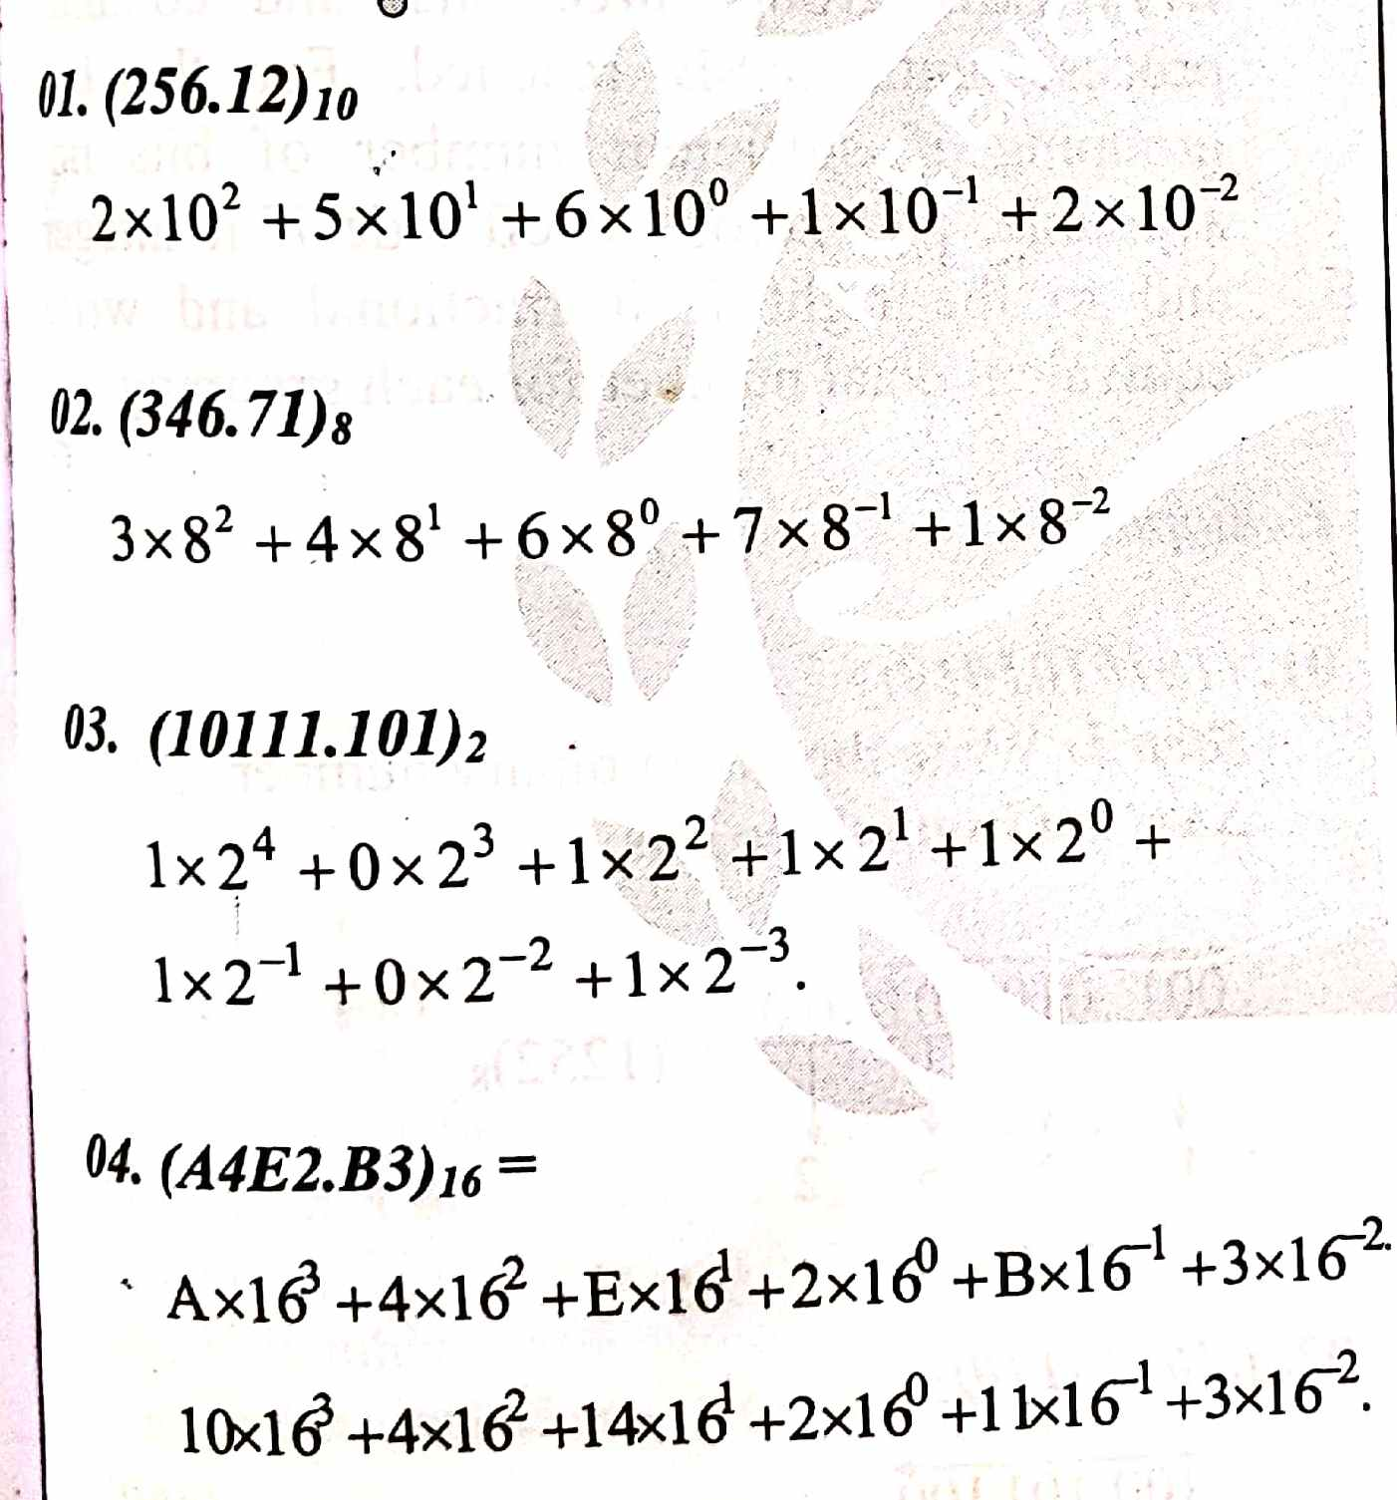
The place or weights of different digits in mixed number system is

Slide 10
Binary to Decimal Conversion Methods
The decimal number system is represented by the digit 0, 1, 2, 3, 4, 5, 6, 7, 8, 9. It consists ten digits and hence the base of the system is 10. Their base is increased by the factor of 10.
On the other hand, the binary number system consists only two digits 1 and 0.The base of the binary number system is 2, and it is increased by the factor of two.
The first digit has 2⁰ weights, the second has 2¹ weights, the weight of the third digit is 2² and so on. Consider a decimal number 3285 it can be written as

Slide 11
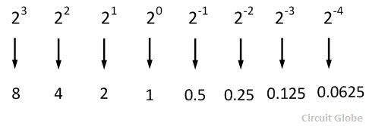
3285 = 3000 + 200 + 80 + 5
3285 = 3(10³) + 2(10²) + 8(10¹) + 5(10⁰)
Thus the decimal number system is an example of positional notation where each digit position has a weight in terms of powers of ten. Similarly, in the binary number system each digit position has a weight regarding powers of two. Some of the examples of a binary digit are shown in the example.

Slide 12
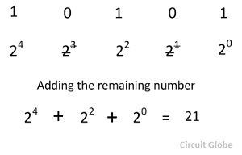
In binary to decimal conversion when there is one in a digit position of a binary number, then the weight of the position is added. But when there is the zero in a binary position the weight of the position is disregarded.
Considered the conversion of the binary number 10101 into its equivalent decimal numbers.
On disregarding the weight 2³ and 2¹ and summing up the remaining weights, we get the equivalent decimal number 21.

Slide 13
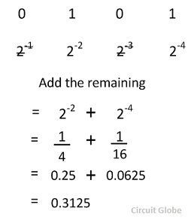
Binary to Decimal Conversion for Fractional Number
For a fractional number, the weights of the digit position to the right of binary point are given by 2⁻¹, 2⁻², 2⁻³, 2⁻⁴… etc. Consider the conversion of a fractional binary number.0101 into its equivalent decimal numbers.
After disregarding the weight 2⁻¹ and 2⁻³ and summing up the remaining weights, i.e., we get the decimal number 0.3125.

Slide 14
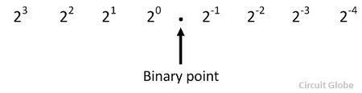
Binary to Decimal Conversion For Mixed Number
The number with an integer and fractional part are called mixed number. The weight for a mixed number can be written as
Consider the conversion of a binary number 1101.101 into its equivalents decimal number

Slide 15
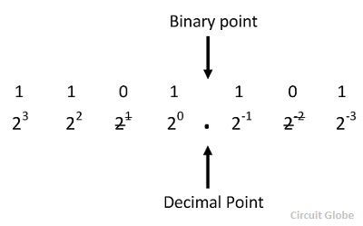
After disregarding the weight 2¹ and 2⁻¹ and on summing up the remaining weights the required decimal number is 13.625.

Slide 16
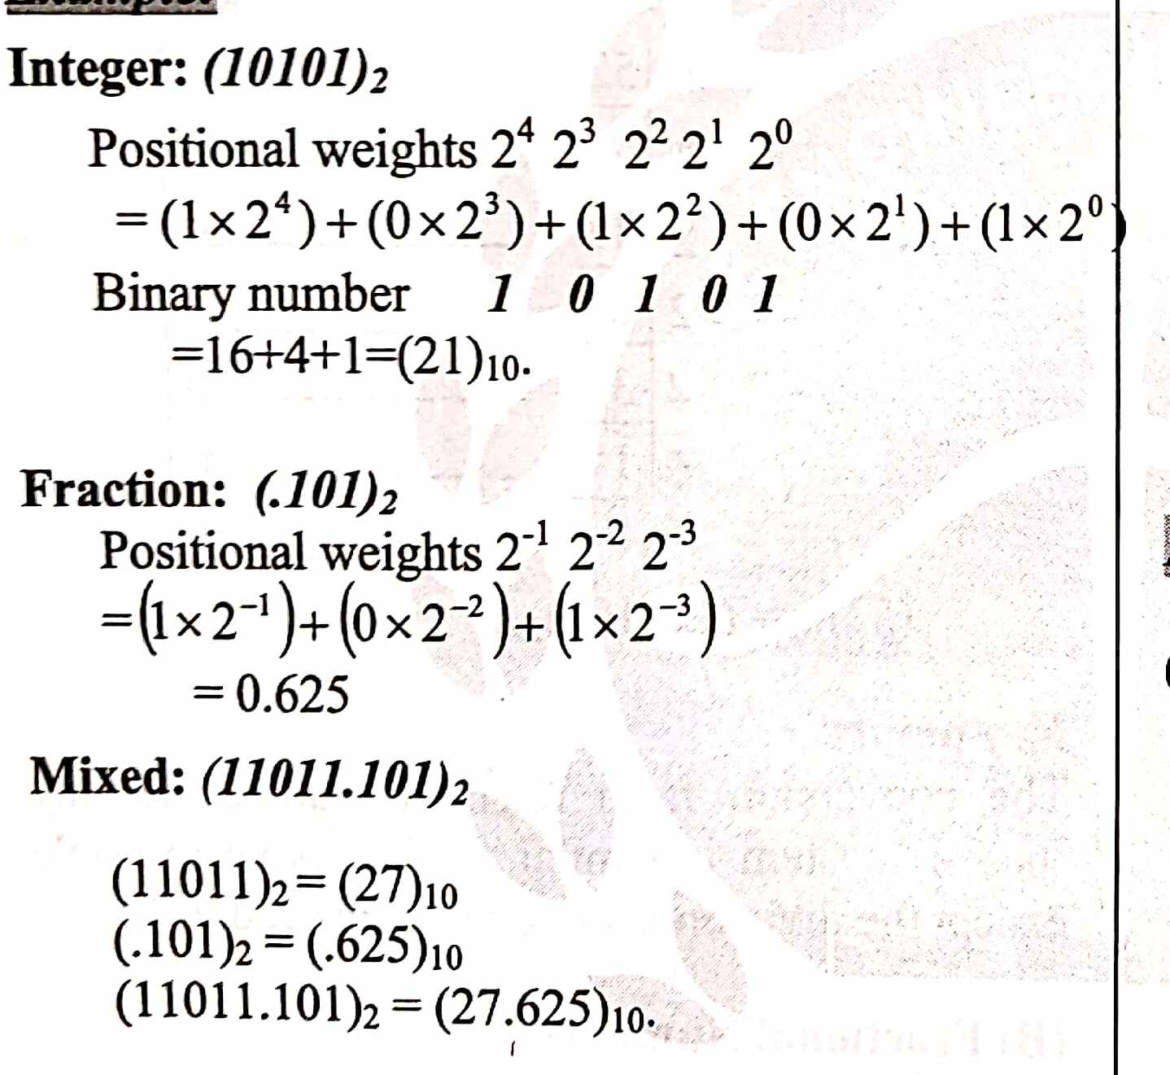

Slide 17
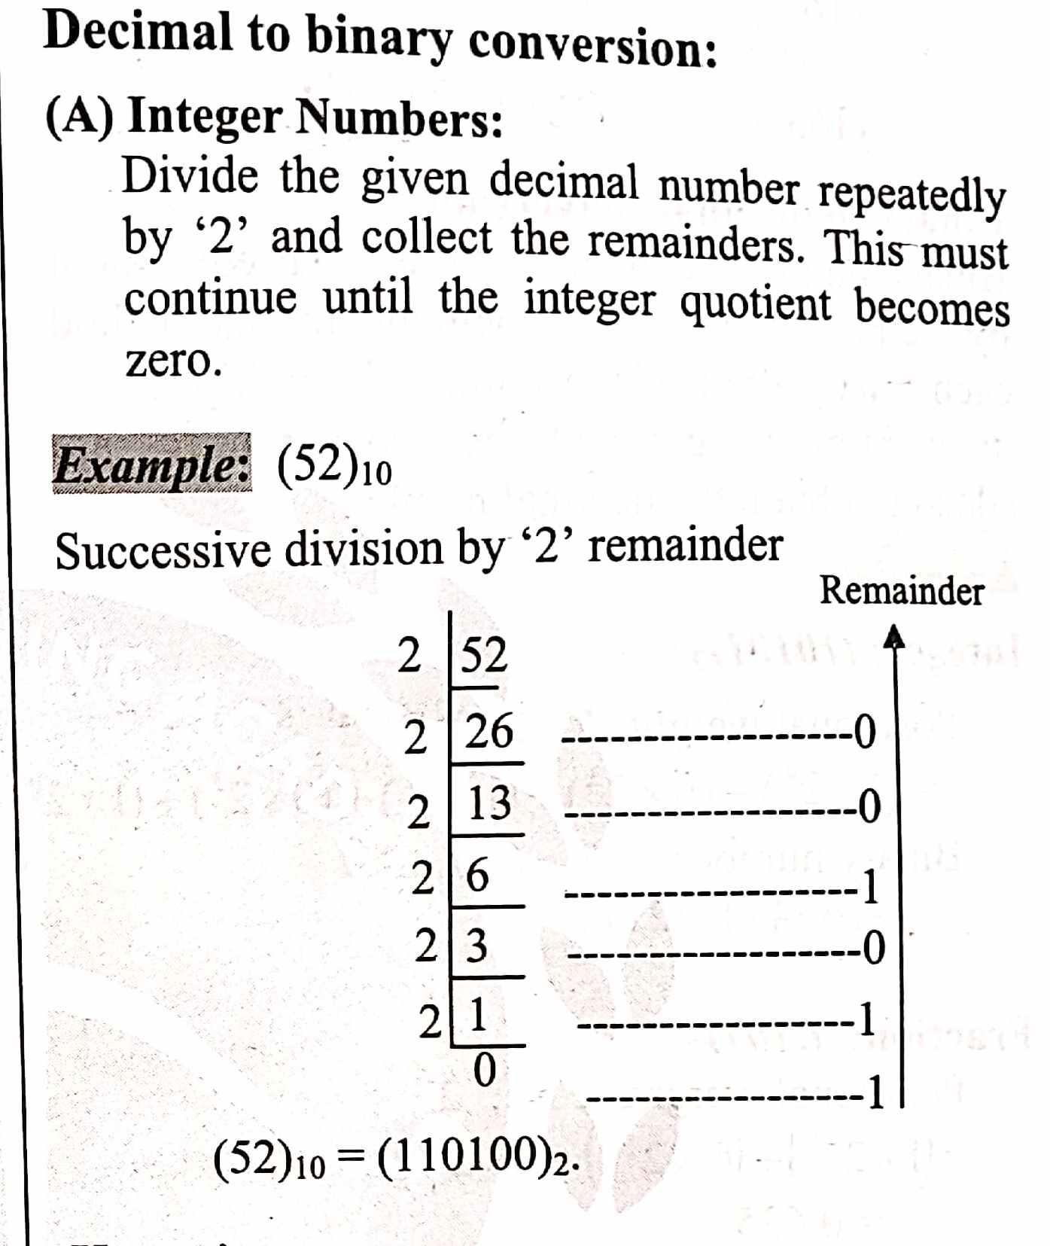

Slide 18
Example #2
Convert 174₁₀ to binary:
Division by 2 | Quotient | Remainder | Bit #
174/2 | 87 | 0 | 0
87/2 | 43 | 1 | 1
43/2 | 21 | 1 | 2
21/2 | 10 | 1 | 3
10/2 | 5 | 0 | 4
5/2 | 2 | 1 | 5
2/2 | 1 | 0 | 6
1/2 | 0 | 1 | 7
So 174₁₀ = 10101110₂

Slide 19
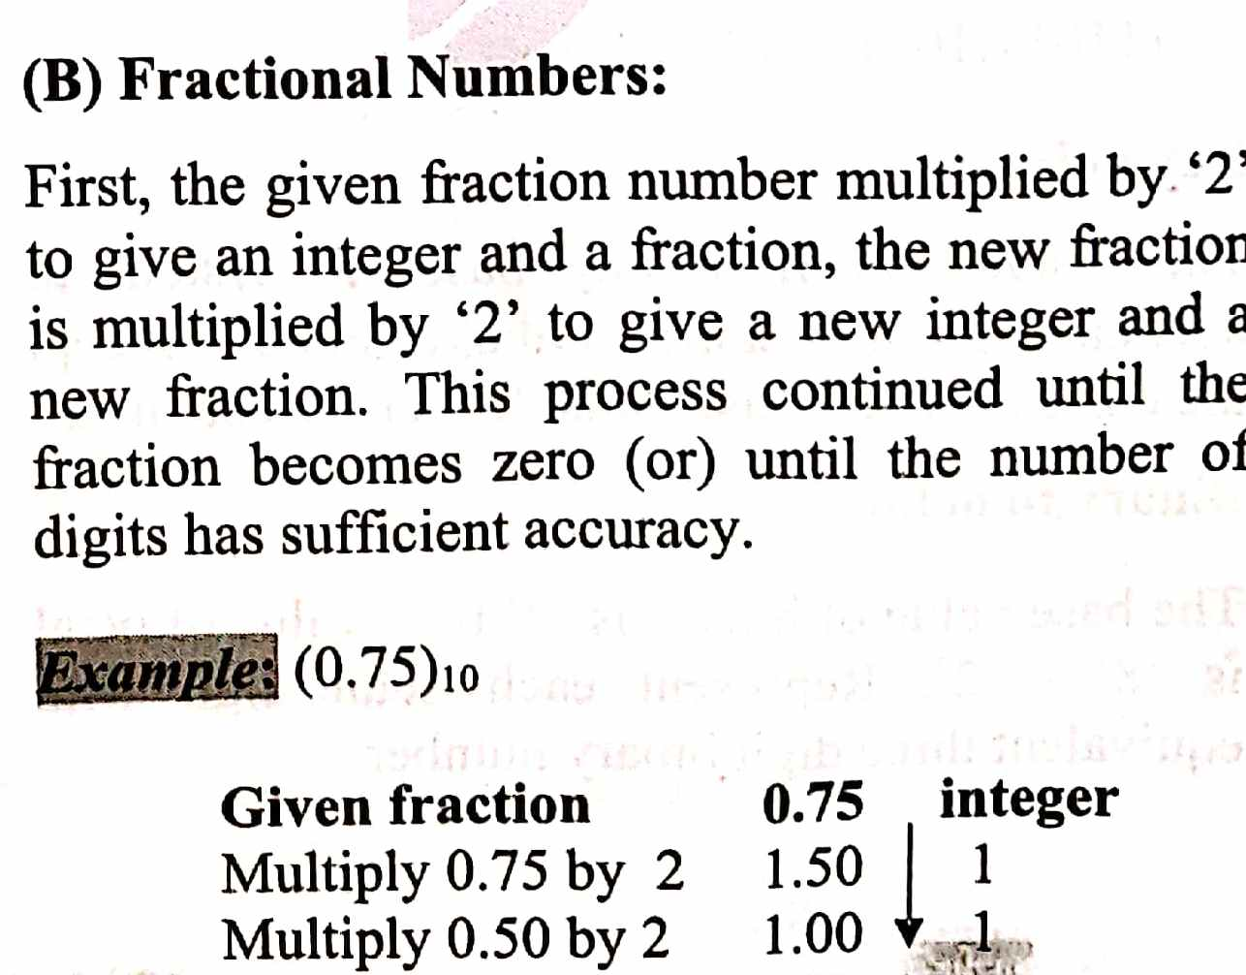
(0.75)=(0.11)

Slide 20
The fractional part of 85.375 is 0.375. Multiply the fractional part repeatedly by 2 until it becomes 0.
0.375 × 2 = 0.750
0.750 × 2 = 1.500
0.500 × 2 = 1.000
From top to bottom, write the integer parts of the results to the fractional part of the number in base 2.
(0.375)₁₀ = (0.011)₂
Combine the whole number and fractional parts to obtain the overall result.
(85.375)₁₀ = (1010101)₂ + (0.011)₂ = (1010101.011)₂

Slide 21
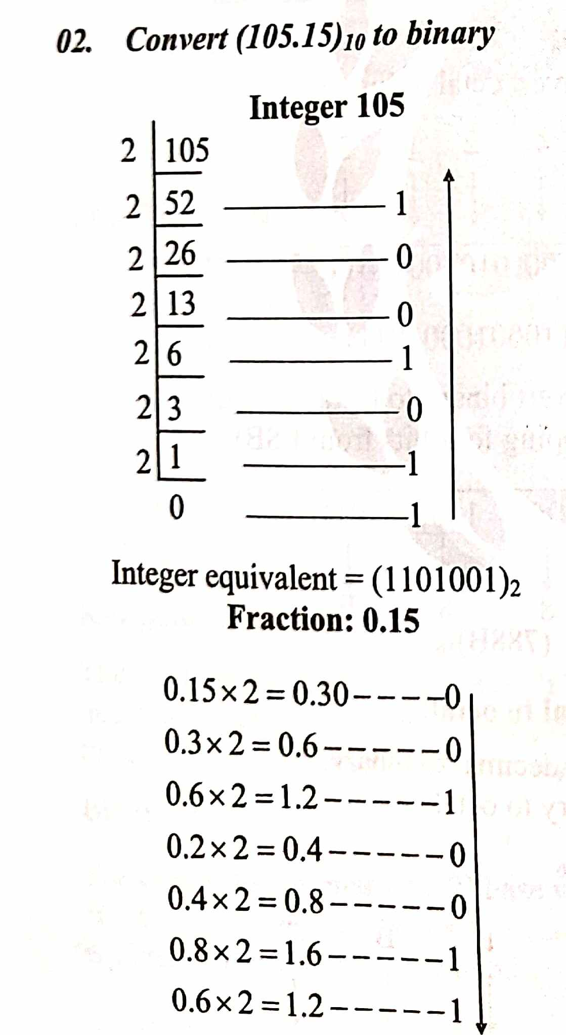

Slide 22
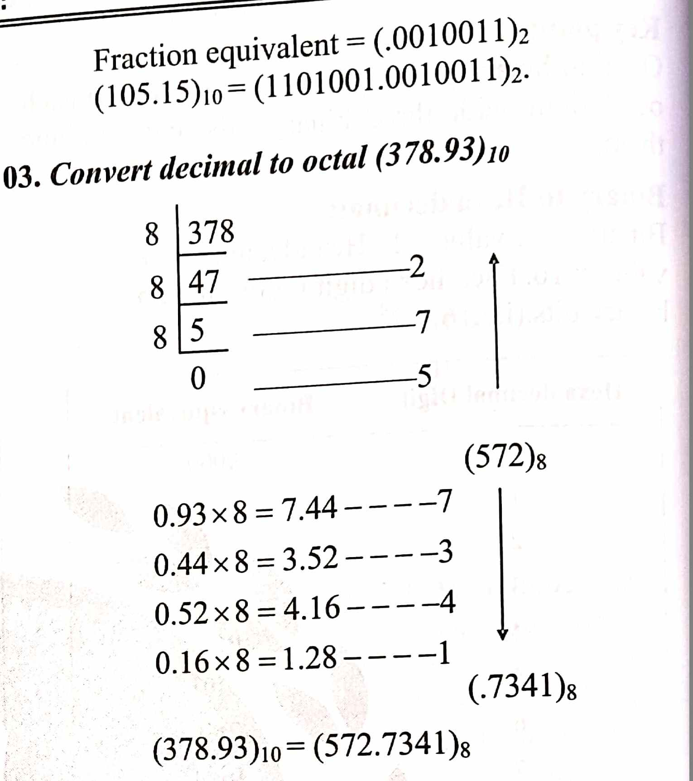

Slide 23
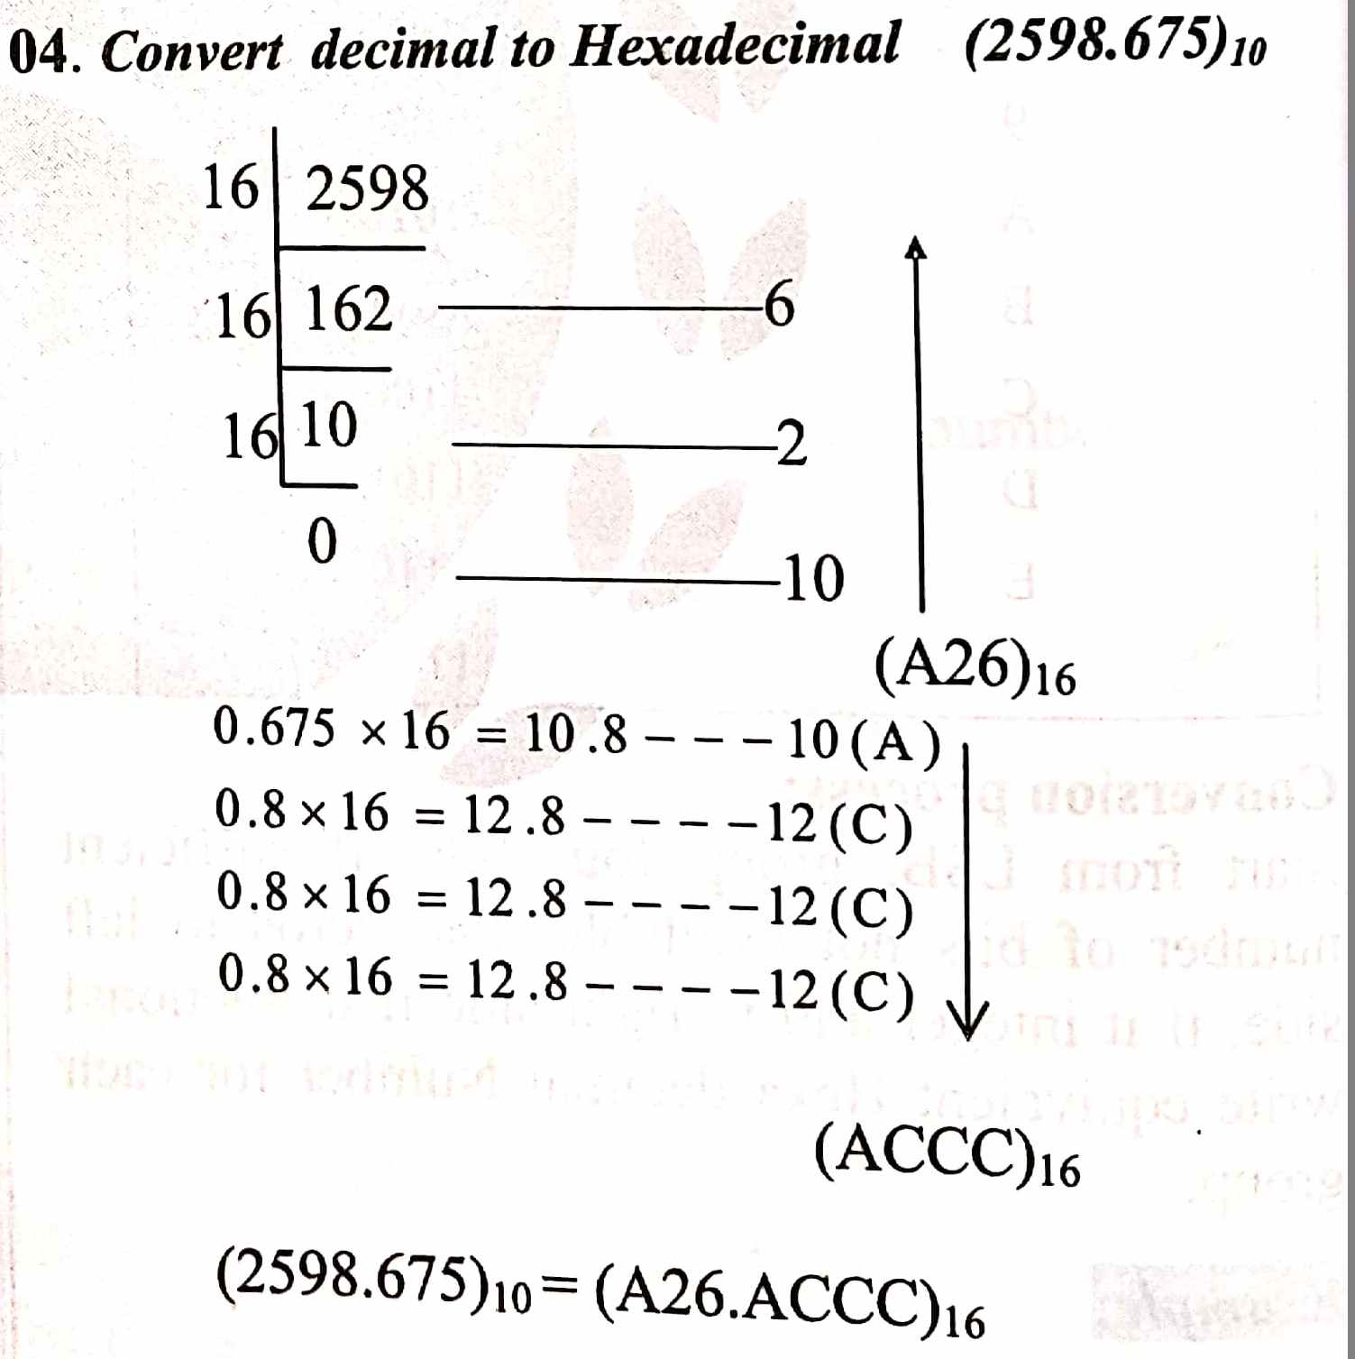

Slide 24
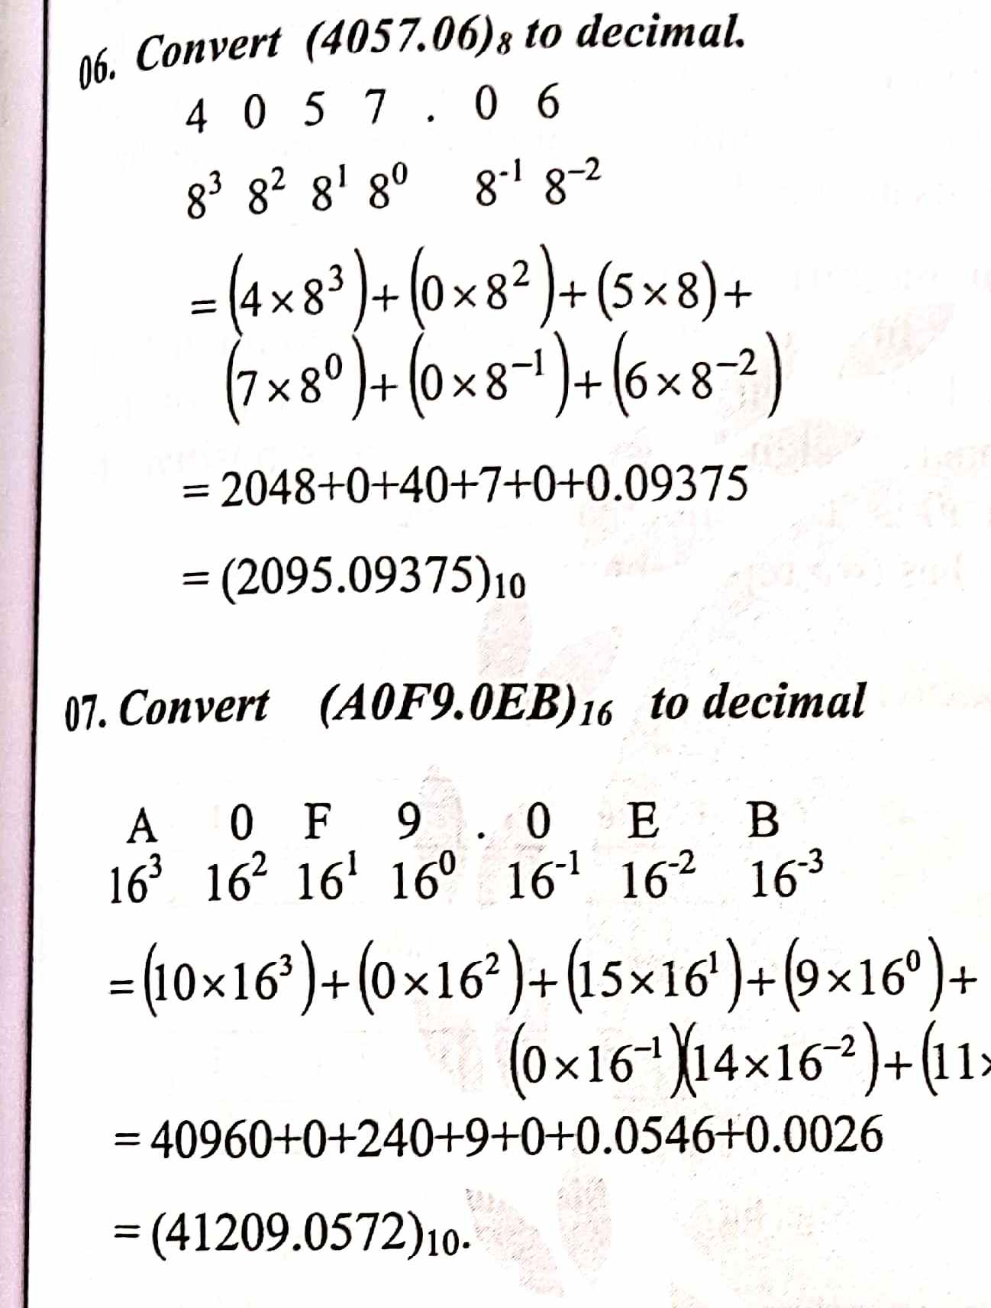

Slide 25
Convert Hexadecimal to Binary
Example #1
Convert (4E)₁₆ to binary:
(4)₁₆ = (0100)₂
(E)₁₆ = (1110)₂ _{So}
(4E)₁₆ = (01001110)₂
Convert Octal to Binary
Example
Convert octal 154₈ to binary:
154₈ = 1 5 4 = 1 101 100 = 1101100₂
Convert Octal to Hexadecimal
Example
Convert octal 154₈ to hex:
Convert every octal digit to 3 binary digits:
154₈ = 001 101 100 = 001101100₂
Then convert every 4 binary digits to 1 hex digit:
001101100₂ = 0110 1100 = 6C₁₆
Convert Binary to Hexadecimal
Example #1
Convert (01001110)₂ to hex:
(0100)₂ = (4)₁₆
(1110)₂ = (E)₁₆ _{So}
(01001110)₂ = (4E)₁₆
Convert Binary to Octal
Example
Convert binary 1101100₂ to octal:
Convert every 3 binary bits (from bit0) to octal digit:
1101100₂ = 1 101 100 = 1 5 4 = 154₈
Convert Hexadecimal to Octal
Example
Convert hex 6C₁₆ to octal:
6C₁₆ = 6 C = 110 1100 = 1101100₂
1101100₂ = 1 101 100 = 1 5 4 = 154₈

Slide 26
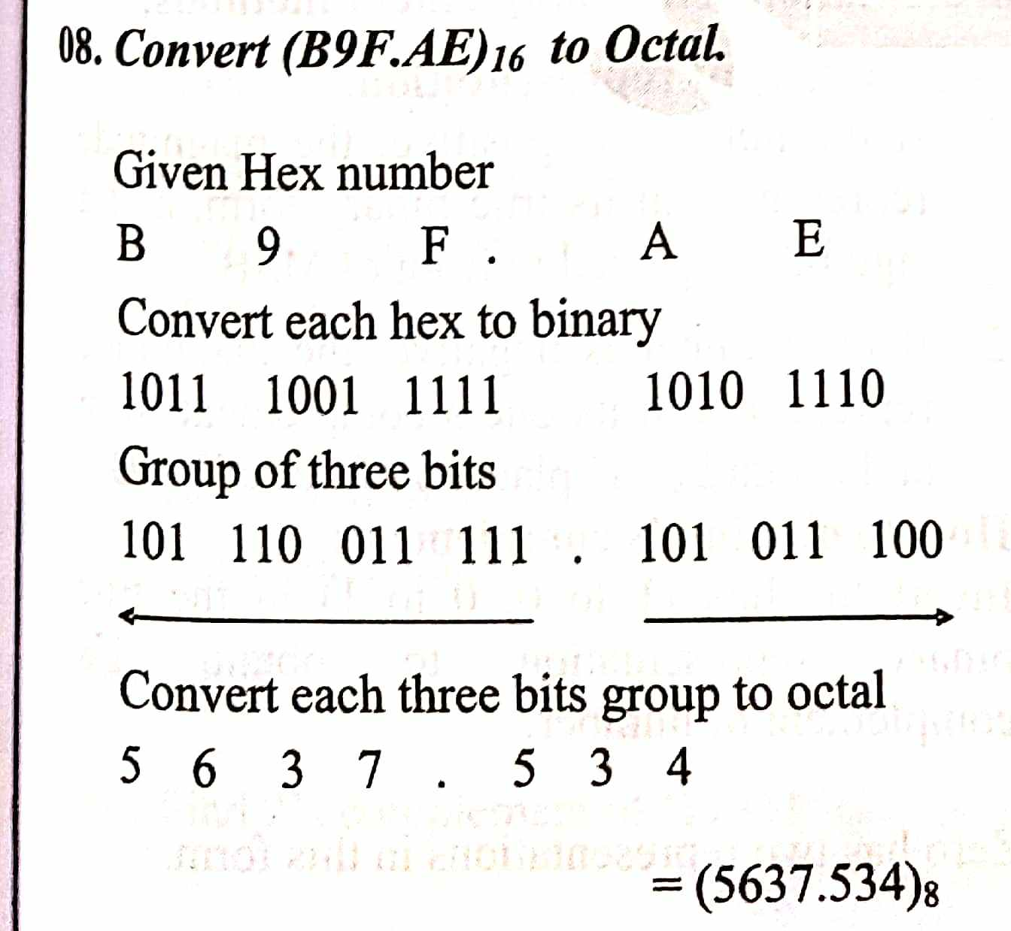

Slide 27
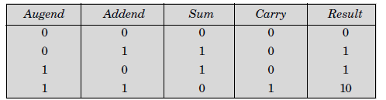
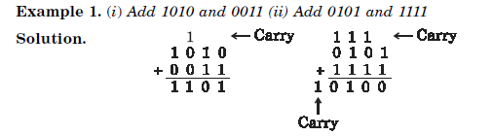
BINARY ARITHMETIC
The binary arithmetic operations such as addition, subtraction, multiplication and division are similar to the decimal number system.
Binary arithmetic's are simpler than decimal because they involve only two digits (bits) 1 and 0.
Binary Addition

Slide 28
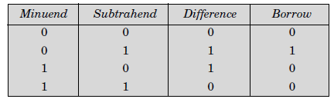
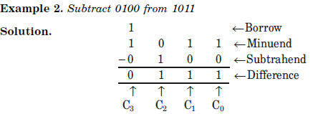
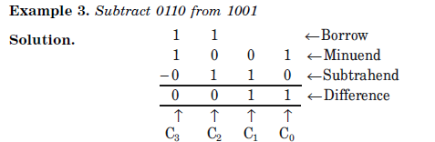
Binary Subtraction

Slide 29
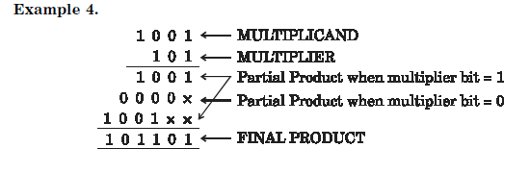
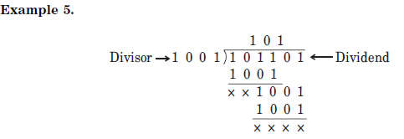
Binary Multiplication
Binary Division

Slide 30
One's complement
One's complement: The ones' complement of a binary number is found by inverting each bit (replacing 0s with 1s and 1s with 0s). For example, the ones' complement of 101100 is 010011. This operation is also known as the bitwise complement or logical complement.
Here's a more detailed explanation:
Inversion:
In a binary number, each digit (bit) is either 0 or 1. The ones' complement involves changing each 0 to a 1 and each 1 to a 0.
Example:
The binary number 1010 has a ones' complement of 0101.
The binary number 0011 has a ones' complement of 1100.
Use in computers:
Ones' complement representation was historically used in some early computers to represent negative numbers. It's less common now, with two's complement being the more prevalent method.

Slide 31
Two's complement
Two's complement: Two's complement is a method of representing signed (positive, negative, and zero) binary numbers in computer systems. It's the most common way to represent integers on computers. In this system, the most significant bit (leftmost) indicates the sign: 0 for positive or zero, and 1 for negative. To find the two's complement of a number, you typically invert all the bits (ones become zeros and zeros become ones) and then add one to the result.
Example:
Let's say you want to find the two's complement of the decimal number -5 (assuming an 8-bit representation):
Binary Representation of 5: 00000101
One's Complement: 11111010
Two's Complement: 11111010 + 1 = 11111011
So, 11111011 is the two's complement representation of -5 in an 8-bit system.

Slide 32
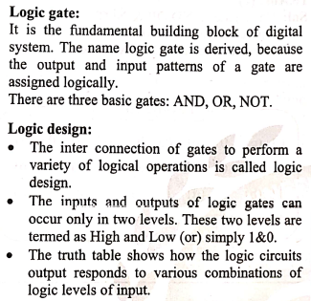
Logic Gates

Slide 33
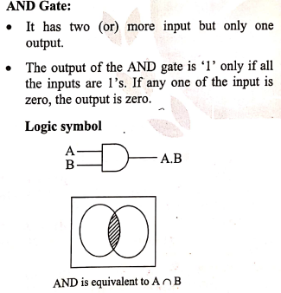

Slide 34
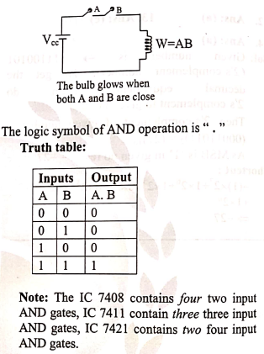

Slide 35
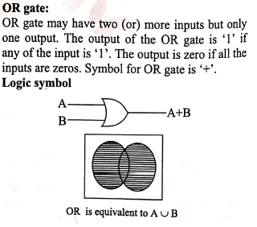

Slide 36
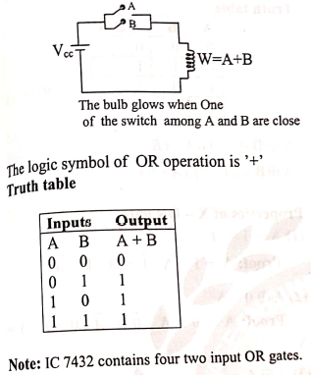

Slide 37
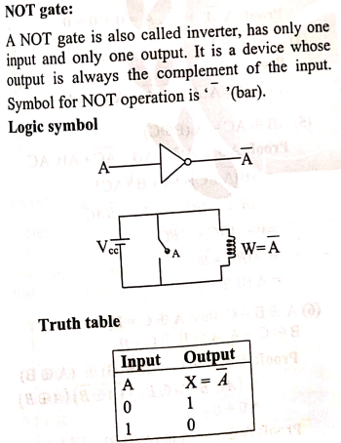

Slide 38
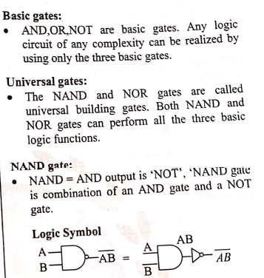

Slide 39
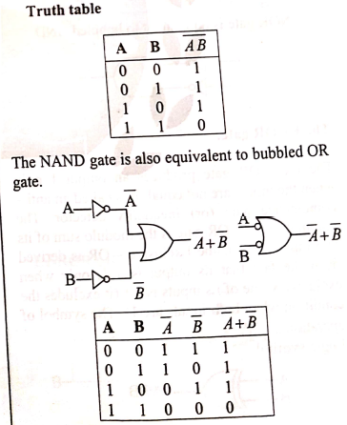

Slide 40
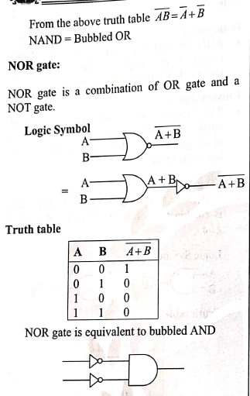

Slide 41
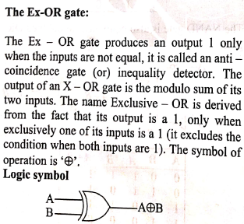
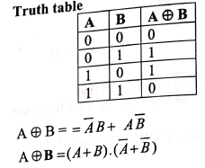

Slide 42
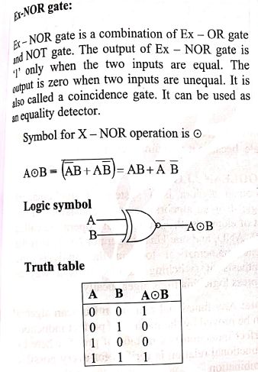

Slide 43
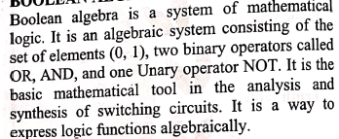
BOOLEAN ALGEBRA
Boolean algebra is the category of algebra in which the variable's values are the truth values, true and false, ordinarily denoted 1 and 0 respectively. It is used to analyze and simplify digital circuits or digital gates. It is also called Binary Algebra or logical Algebra.

Slide 44
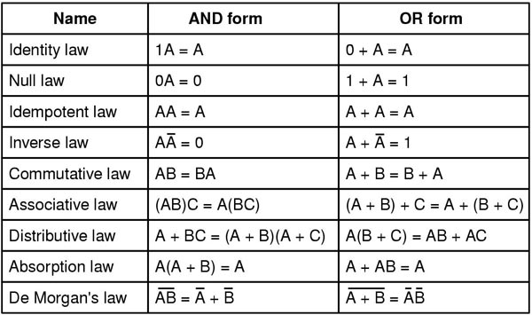
Boolean Algebra Simplification and how to simplify Boolean algebra expressions using some basic rules applied to their variables, literals and terms.

Slide 45
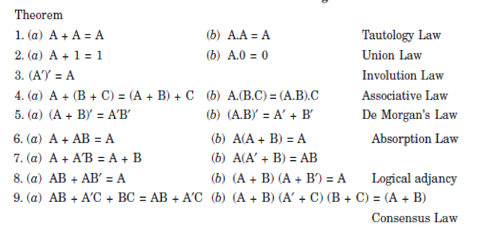
Basic Theorems and Properties of Boolean Algebra

Slide 46
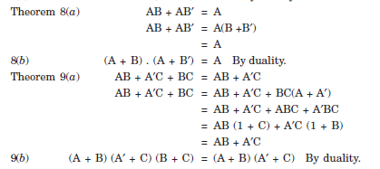

Slide 47
K map (Karnaugh map)
A Karnaugh map (K-map) is a graphical tool used in digital electronics to simplify Boolean expressions, which helps in minimizing the number of logic gates needed in a circuit.
By visually organizing truth table values into a grid, K-maps allow for the identification of adjacent cells representing minterms or maxterms, which can be grouped together to derive simplified expressions in either Sum of Products (SOP) or Product of Sums (POS) form.
In realization of digital electronic systems, the simplification of Boolean expressions is one of the most crucial steps because it reduces the hardware complexity and cost of production.
There are several tools and methods available for simplifying complex Boolean expression. K-Map or Karnaugh Map is one of such simplification methods.
The K-Map or Karnaugh map makes the use of two dimensional table for simplification of the Boolean functions. The size of this table increases considerably with the increase in the number of variables in the Boolean functions.
Some typical examples of K-Map of two variable, three variable, and four variables are shown in Figure-1.

Slide 48
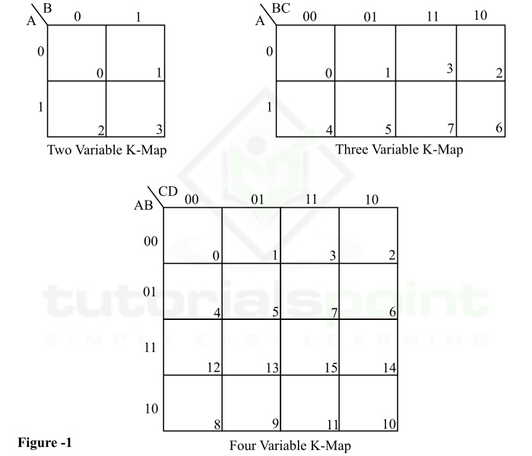
From Figure-1, it is clear that the number of squares or cells in the Karnaugh map depends on the number of variables in the expression.
If n is the number of variables in the given Boolean function, then the corresponding Karnaugh map (K-Map) will have 2^{n} squares or cells. For examples, if the number of variables in the Boolean function is 3, then the corresponding K-Map will have 8 (= 2³) cells.

Slide 49
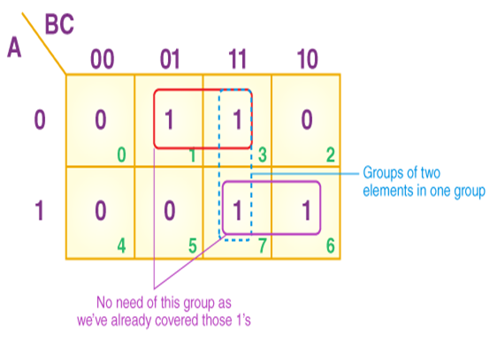
K-map can take two forms:1.Sum of product (SOP) and 2.Product of Sum (POS)
SOP Form: The Sum of Products (SOP) form is a Boolean expression format where each product term represents a minterm. In K-Map simplification, you group the 1s to minimize the SOP expression.
Example of SOP Form Simplification: If the truth table has the following minterms: m(1),m(3),m(7)�(1),�(3),�(7), fill the K-Map with 1s in the corresponding cells. Group the 1s and derive the minimized Boolean expression in SOP form.
Problem on 3 variables K-map: Z = ∑P, Q, R (1, 3, 6, 7)
The sum these product terms, then we will get this final expression
Y= (P’R + PQ)

Slide 50
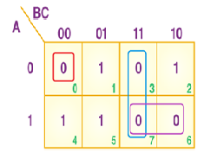
POS Form
The Product of Sums (POS) form represents Boolean functions in terms of maxterms. Each product term in a POS expression is a sum of literals, corresponding to a 0 in the truth table.
Example of POS Form Simplification:
For the same Boolean function with maxterms M(0),M(2),M(4), you would fill the K-Map with 0s in the corresponding cells and group them to derive the simplified POS expression
POS FORM
1. 3 variables K-map
F (P, Q, R) = π(0,3,6,7)
If we take the product of these three terms, then we will get this final expression –
Y=(P’ + Q’) (P’ + R’) (P + Q + R)

Slide 51

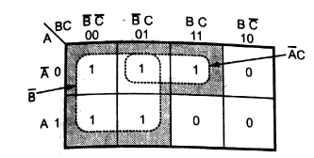
K map (Karnaugh map) SOP (Sum of Products) Form
The function Y in SOP form

Slide 52

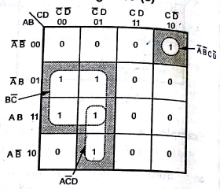


Slide 53
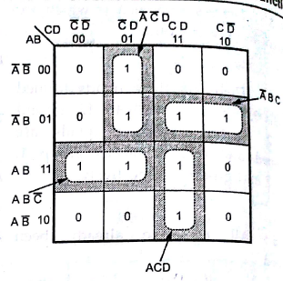


Slide 54

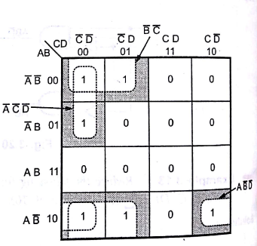

Slide 55
THANK YOU

